Slide 1
Topics
Environment mgmt ,Python version mgmt , Package mgmt
Dependencies
Global vs Virtual Environment.
Why we need Environment .
Poetry

Slide 2
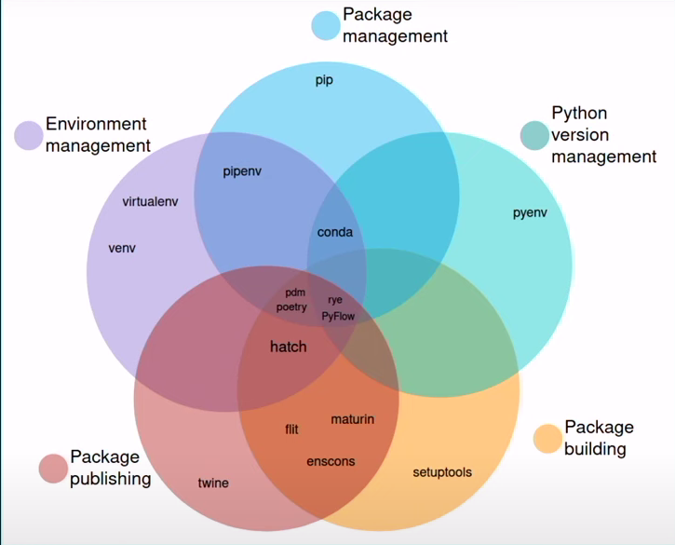
The current ecosystem
Python version management
Environment management
Package management

Slide 3

Python version mgmt
Ensures Compatibility: Different projects , diff versions .
Avoids Conflicts: Managing dependencies, packages, and libraries.
Pyenv – package .
Isolation: ,Version Control:

Slide 4

Environment management
Global environment :When you install Python on your system, it creates a global environment. This environment contains the Python interpreter and the standard library.
Virtual environment : Virtual environments are isolated environments created specifically for individual projects.Each virtual environment has its own Python interpreter, and it can have its own set of dependencies, packages, and libraries.

Slide 5
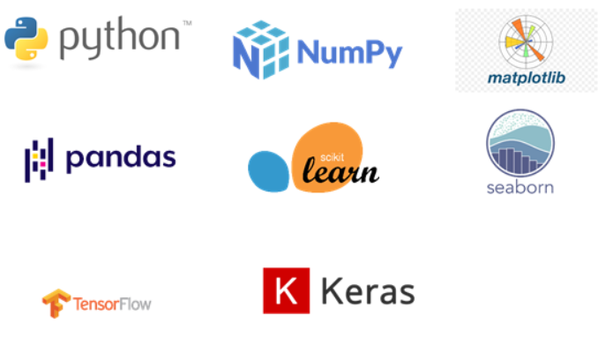
Package management
Dependencies are external packages or libraries that your Python project relies on to function correctly.eg : pandas , numpy etc

Slide 6

Libraries used
pyenv - for python version management
virtualenv - for environment management
Pip – for package management
Ipkernel – for creatin kernals

Slide 7
